Slide 1
Research Paper I – Thesis Pennsylvania State University Schreyer Honors College
COMMON TECHNICAL INDICATORS AND
THEIR IMPACT ON STOCK PRICES
RYAN YOUNG

Slide 2
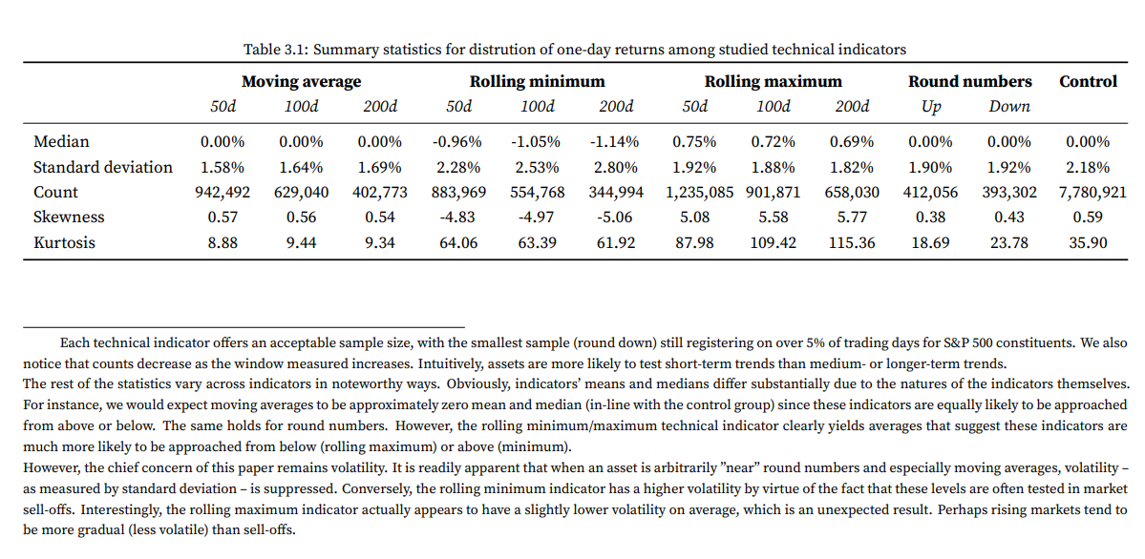

Slide 3
Research Paper II - IJEAST
LITERATURE SURVEY ON STOCK PRICE PREDICTION USING MACHINE LEARNING
Anusha J Adhikar
Charitha G
Apeksha K Jadhav
Karishma KH
Mrs. Supriya HS

Slide 4
This proposed system makes use of data taken from Yahoo finance, trained and tested. The LSTM RNN model used for the prediction is found out to be very effective and resembles the actual trend very well. The results obtained on the training dataset had a Mean Square Error of 0.00106 and a Root Mean Square Error of 0.03. The results on the testing data had a Mean Square Error of around 0.00875 and a Root Mean Square Error of around 0.09. The larger the dataset and more the frequency of training higher will be the accuracy that will be obtained.

Slide 5
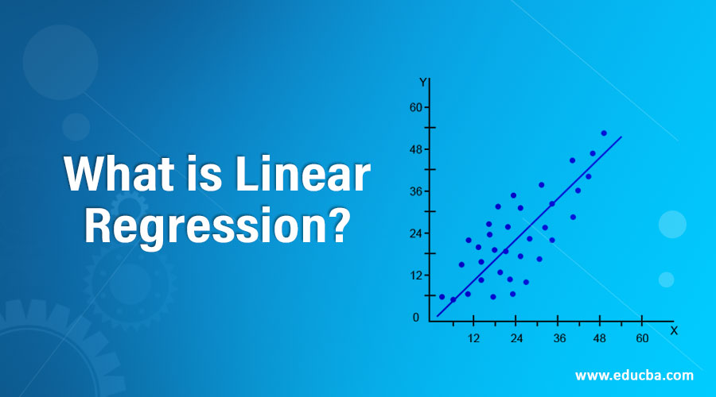

Slide 6
Why use Linear Regression?
Technicians and quant traders often work one system for a particular security or stock and find that the same parameters won't work on other securities or stocks. The beauty of linear regression is that the security's price and time period determine the system parameters. Use these tools and the rules defined above on various securities and time frames and you will be surprised by its universal nature.

Slide 7
Linear regression performs the task to predict a dependent variable value (y) based on a given independent variable (x). So, this regression technique finds out a linear relationship between x (input) and y(output). Hence, the name is Linear Regression.

